Slide 1
Maryland Maternal Health Improvement Task Force
2025 Fall Quarterly Meeting
November 20, 2025

Slide 2
Housekeeping
Virtual
Please keep yourself on mute unless speaking
Attendance will be recorded

Slide 3
Group Agreements
Be Present – Make a conscious effort to know who is in the room, become an active listener. Refrain from multitasking and checking emails during meetings.
Call Each Other In As We Call Each Other Out – When challenging ideas or perspectives give feedback respectfully. When being challenged - listen, acknowledge the issue, and respond respectfully.
Recognize the Difference of Intent vs Impact – Be accountable for our words and actions
Create Space for Multiple Truths – Seek understanding of differences in opinion and respect diverse perspectives.
Notice Power Dynamics – Be aware of how you may unconsciously be using your power and privilege.
Center Learning and Growth – At times, the work will be uncomfortable and challenging. Mistakes and misunderstanding will occur as we work towards a common solution. We are here to learn and grow from each other both individually and collectively.

Slide 4
Agenda
Welcome and Opening Remarks
Task Force Business
Review of 2025 Strategic Plan
Review of Task Force-Specific Activities
Operations Update
Next Steps & 2026 Meetings

Slide 5
Welcome + Opening Remarks

Slide 6
Task Force Business

Slide 7
Operations Updates
2026 Meetings
  Complete this survey to indicate preferences
Transition to in-person meetings in 2026
Recruitment of Co-Chair
MHITF Membership updates

Slide 8
Maternal Health 2025 Strategic Plan

Slide 9

Maternal Health 2025 Strategic Plan
Submitted to HRSA in September 2025
Available on MDMOM website
Direct report link: https://mdmom.org/sites/default/files/documents/taskforce/Maryland_Maternal_Health_Improvement_Strategic_Plan_2025_vF.pdf

Slide 10
Review of Strategic Plan 2.0 Revision Process

Slide 11
HRSA Strategic Plan Requirements
By September 29, 2024, 100 percent of recipients will have developed a draft strategic plan to improve maternal health
Including addressing identified health disparities and other gaps and incorporating activities outlined in the State Title V Needs Assessment.
The Maternal Health Strategic Plan should reflect the most recent maternal health data available.
By September 29, 2025, each recipient and their established Maternal Health Task Force will update and finalize the Maternal Health Strategic Plan:
by increasing the number of actionable recommendations based on state-level maternal health data
Submit a final strategic plan to guide the work of the MHTF and the State MHI Program throughout the remainder of the project period.
Objectives

Slide 12
Strategic Plan Revision Timeline
July 2024 - Planning retreat to identify priorities
January 2025 - Initial feedback from HRSA
May-July 2025 - Support for consultant to identify and refine priorities, goals, and objectives
September 2025 - Submission of final plan

Slide 13
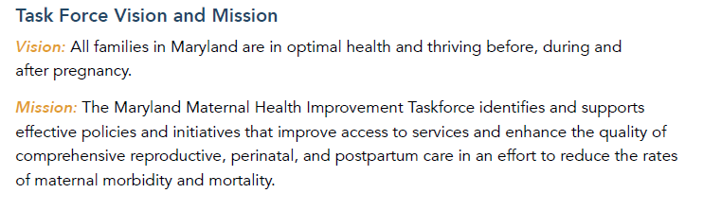
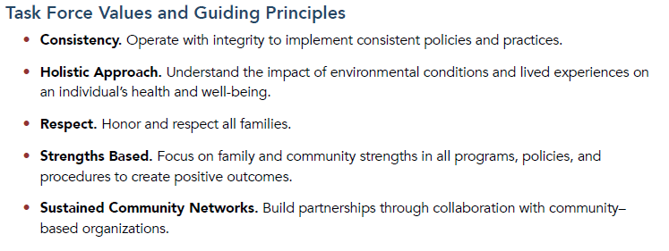
Updated Mission, Vision, and Values

Slide 14
Overarching Priorities
Increase access to high-quality, consistent perinatal care | Address lack of funding for maternal health services and perinatal insurance coverage
Ensure access to mental and behavioral health specialties | Improve data analysis and and timely dissemination of maternal health trends data
Address increasing trend in substance use overdose deaths | Sustain networks and increase collaborations among maternal health stakeholders
Increase social support and opportunity for perinatal health education among pregnant and postpartum women, their support networks, and health care providers | Consistency and availability of care
Support the creation of a multifaceted, holistic birth workforce. | Address morbidity and mortality of mothers and infants

Slide 15
Changes between 2021 and 2025 Strategic Plans
Updated to reflect current maternal health landscape
Incorporation of 2025 Title V Needs Assessment
Revised & increased number of priorities
Goals tailored to four areas:
  Perinatal care
  Mental & behavioral health
  Integrated services
  Data infrastructure

Slide 16
2025 Goals and Objectives

Slide 17
2025 Goals
Goal 1: Prevent complications of pregnancy.
Goal 2: Improve maternal mental/behavioral health through enhanced screening, diagnosis, and treatment.
Goal 3: Support pregnant and postpartum women and their families by connecting them with comprehensive services
Goal 4: Improve the ongoing collection and utilization of data on maternal health, maternal mortality, and severe maternal morbidity.

Slide 18
Goal 1: Prevent complications of pregnancy
Obj 1.a. Increase the proportion of pregnant women who receive comprehensive postpartum care by 12 weeks following delivery.
Obj 1.b: Ensure standardized maternal urgent warning signs education is incorporated into the perinatal care continuum so that all pregnant women, their families/support networks, healthcare providers, and clinical support staff are exposed to the information.

Slide 19
Goal 1: Prevent complications of pregnancy
Obj 1.c: All hospitals will use evidence-based and comprehensive prevention strategies to lower severe maternal morbidity.
Obj 1.d: Improve prevention, diagnosis, and treatment of hypertension across the perinatal continuum.
Obj. 1.e: Improve prevention, diagnosis, and treatment of diabetes and reduce obesity in preconception women.

Slide 20
Goal 2: Improve maternal mental/behavioral health through enhanced screening, diagnosis, and treatment
Obj. 2.a: Enhance screenings (i.e., SBIRT), counseling, and medical and non-medical therapies for behavioral health conditions, including substance use disorders, depression, and anxiety.
Obj. 2.b: Train the perinatal work force to provide mental and behavioral health support to pregnant and postpartum postpartum women and their families

Slide 21
Goal 3: Support pregnant and postpartum women and their families by connecting them with comprehensive services
Obj. 3.a: Increase pregnancy and postpartum referrals and connections to services.
Obj. 3.b: Increase enrollment in evidence-based and promising practice home visiting programs that provide comprehensive case management.

Slide 22
Goal 4: Improve the ongoing collection and utilization of maternal health data
Obj. 4.a: Annually evaluate the causes of maternal mortality (MMRT) and severe maternal morbidity in Maryland through analysis of surveillance data and facility-based case reviews with a focus on risk factors and underlying causes.
Obj. 4.b: Enhance maternal health surveillance and quality initiatives through the collection of qualitative data that captures the perspectives of mothers.
Obj. 4.c: Disseminate maternal health data using a centralized state-wide maternal health data reporting tool

Slide 23
Action Plan and Task Force-Specific Deliverables

Slide 24
2025 Strategic Plan Action Plan
Begins on Page 37
Outlines specific tactics, group(s) responsible, and metrics of success
Task Force is responsible lead in 4 tactics
  Consulted partner in 6 tactics

Slide 25
Task Force-led Tactics
Objective 1a: Increase the proportion of pregnant women who receive comprehensive postpartum care by 12 weeks following delivery.
Tactic | Metric
Tactic 1.a.1: Convene a meeting with lead and key partners to develop a strategy and workplan that identifies key interventions to ensure all women receive two postpartum visits within 12 weeks after delivery [Timeline: 2025-2026] | Metric: Percent of women who attend a postpartum checkup within 12 weeks after giving birth. [Source: PRAMS]

Slide 26
Task Force-led Tactics
Objective 1.e: Improve prevention, diagnosis, and treatment of diabetes and reduce obesity in preconception women
Tactic | Metric
Tactic 1.e.1: Establish partnerships with stakeholders to increase awareness and education. [Timeline: 2025-2026] | Metric: Roadmap is created. [Source: MHITF]
Tactic 1.e.2: Create a maternal health roadmap with a focus on preconception health, including diabetes and obesity. [Timeline: 2027]

Slide 27
Task Force-led Tactics
Objective 2.b: Train the perinatal work force to provide mental and behavioral health support to pregnant and postpartum women and their families.
Tactic | Metric
Tactic 2.b.2: Conduct and disseminate findings from a needs assessment that identifies barriers to accessing perinatal mood and anxiety disorder treatment. [Timeline: 2026] | Metrics: Needs assessment findings presented to the MHITF. [Source: MDH]
Tactic 2.b.4: Expand utilization of existing resources and materials already developed (e.g.,988 and the Maryland Maternal Health Resource Map). [Timeline: 2025-2030]

Slide 28
Task Force-Consulted Tactics
Tactic 1.c.1 | Tactic 3.a.2 | Tactic 4.b.2
Tactic 1.c.2 | Tactic 3.a.3 | Tactic 4.b.3
Tactic 1.d.1 | Tactic 4.a.1 | Tactic 4.c.1
Tactic 1.d.2 | Tactic 4.a.2 | Tactic 4.c.2
Tactic 1.d.3 | Tactic 4.a.3 | Tactic 4.c.3
Tactic 3.a.1 | Tactic 4.b.1

Slide 29
Implementation Plan & Task Force Engagement

Slide 30
Group Discussion Questions
How should we utilize work groups to support implementation of Task Force led activities?
How would the Task Force like to be consulted on activities where it is not the lead?

Slide 31
Next Steps

Slide 32
2026 Quarterly meetings
TBD

