Slide 1
Maryland Maternal Health Improvement Task Force
Winter Quarterly Meeting
January 28, 2025

Slide 2
Housekeeping
In-person
Please sign in!
Online
Please add your name and organization to the chat!

Slide 3
Group Agreements
Be Present – Make a conscious effort to know who is in the room, become an active listener. Refrain from multitasking and checking emails during meetings.
Call Each Other In As We Call Each Other Out – When challenging ideas or perspectives give feedback respectfully. When being challenged - listen, acknowledge the issue, and respond respectfully.
Recognize the Difference of Intent vs Impact – Be accountable for our words and actions
Create Space for Multiple Truths – Seek understanding of differences in opinion and respect diverse perspectives.
Notice Power Dynamics – Be aware of how you may unconsciously be using your power and privilege.
Center Learning and Growth – At times, the work will be uncomfortable and challenging. Mistakes and misunderstanding will occur as we work towards a common solution. We are here to learn and grow from each other both individually and collectively.

Slide 4
Agenda
Welcome and Opening Remarks
Introduction of new members
Review of Strategic Plan 2.0 Revisions
Group Discussion
Next steps and action items

Slide 5
Welcome + Opening Remarks

Slide 6
Introduction of New Members

Slide 7
Strategic Plan 2.0 Revisions

Slide 8
Goal of Strategic Plan 2.0 Revision Process

Slide 9
Overview of the Project
MDMOM 2.0 funded from 2023-2028
  Currently in Year 2 (Sept 2024-Sept 2025)
Required by HRSA as part of MDMOM 2.0 to prepare revised strategic plan (Strategic Plan 2.0)
Ongoing Task Force discussion

Slide 10
Key Dates and Requirements

Slide 11
Timeline (Year 1, 2023-2024)
Milestone | Deadline | Deliverables
Task Force Ideation and Proposal of New Activities & Objectives | By end of May 2024 | Updated list of activities based on tactics outlined in Strategic Plan 1.0 Action Plan. Updated objectives and tactics based on Task Force input reflecting “Reform, Retrofit, Reimagine” framework. Discussions held with Task Force working groups to inform updates.
Develop draft updates to 2021 Strategic Plan | By July 2024 (Presented at Summer meeting to TF) | Draft revised strategic plan (outline)
Draft plan submitted to HRSA | By Sept. 29, 2024 | Submitted draft
Notes:
“Report” is a placeholder term - what would the group want to see? The goal of this product is to provide updates and continue the momentum of the task force’s work.

Slide 12
Timeline (Year 2, 2024-2025)
Milestone | Deadline | Deliverables
Task Force Review of SP 2.0 Draft & Accountability | By end of February 2025* | Updated list of activities to achieve objectives and goals Measures of accountability (target outcomes, indicators, etc.) *Title V Needs Assessment done tent. Late Feb/March 2025
Draft final strategic plan content and design | By July 2025 (Presented at April and Summer meeting to TF) | Revised SP 2.0 (Final draft)
Final plan submitted to HRSA | By Sept. 29, 2025 | Final plan submitted
Notes:
“Report” is a placeholder term - what would the group want to see? The goal of this product is to provide updates and continue the momentum of the task force’s work.

Slide 13
Timeline (Years 3-5, 2025-2028)
Milestone | Deadline | Deliverables
?
Notes:
“Report” is a placeholder term - what would the group want to see? The goal of this product is to provide updates and continue the momentum of the task force’s work.

Slide 14
Strategic Plan Requirements (from HRSA)
By September 29, 2024, 100 percent of recipients will have developed a draft strategic plan to improve maternal health
Including addressing identified health disparities and other gaps and incorporating activities outlined in the State Title V Needs Assessment.
The Maternal Health Strategic Plan should reflect the most recent maternal health data available.
By September 29, 2025, each recipient and their established Maternal Health Task Force will update and finalize the Maternal Health Strategic Plan:
by increasing the number of actionable recommendations based on state-level maternal health data
Submit a final strategic plan to guide the work of the MHTF and the State MHI Program throughout the remainder of the project period.
Objectives

Slide 15
Strategic Plan Requirements (from HRSA), cont.
Overview of Maternal Health and Resources
Identify state-level maternal health strengths, challenges, and gaps in improving maternal health and wellness
Existing maternal health initiatives within your state; and,
The MHSP should reflect and include the alignment of the most recent maternal health data available
  i.e. Maternal Mortality Review Committee (MMRC) findings and recommendations, state maternal mortality and/or severe maternal morbidity reports, Title V Needs Assessment, etc.

Slide 16
Strategic Plan Requirements (from HRSA), cont.
Description of Maternal Health Task Force
Mission, vision and key drivers;
Membership by organization name and roles
Percent makeup of the MHTF (clinical vs community members); and,
Overview of meeting frequency and planned activities for the remainder of the project period.

Slide 17
Strategic Plan Requirements (from HRSA), cont.
State MHI Program Goals and Strategic Plan
Highlight your overarching program goals from 2023 – 2028;
Outline strategies to address maternal health needs in the below topic areas. Detail timeline for strategies to be initiated and implemented, and who is responsible:
  Direct clinical care
  Workforce training
  Maternal health data enhancements
  Community engagement
  Other (specify)
Identify how maternal health strategies align with the most recent Title V Needs Assessment and State Action Plan.
Highlight the innovations that will be implemented to support maternal health. Provide a rationale as to what makes it innovative in your state.

Slide 18
SP 2.0 Draft Goals and Objectives

Slide 19
Summary of Revised SP 2.0 Goals and Objectives
Overarching Goal: Promote Equity and Mobilize against Racism in Maternal Health
Goal 1: Achieve maternal health (across the preconception, prenatal and birth, postpartum and interconception periods) through the implementation of effective and accountable community-based programs, legislative action and advocacy for necessary policy change grounded in ongoing input and regular feedback from the birthing community.
Goal 2: Develop strategies that acknowledge the influence of the social and structural determinants of health and racism and cultivate an environment in which birthing people, families, and communities thrive.
Goal 3: Improve the ongoing collection and utilization of data on maternal health outcomes (including data on structural racism and its impact on maternal health) to help birthing people make informed family planning and healthcare decisions.

Slide 20
Summary of Revised SP 2.0 Goals and Objectives
Overarching Goal: Promote Equity and Mobilize against Racism in Maternal Health
Goal 4: Ensure that the state of Maryland has a diverse, well-trained and accessible workforce of maternal health providers, advocates and support staff that represents the birthing community and offers services based on the principles of cultural humility, equity, and racial justice. This workforce is expected to provide equitable and universal maternal healthcare within a framework of evidence based, consistent standard of care and accountability that aims to eliminates health disparities and barriers to care for birthing persons in Maryland.
Goal 5: Develop equitable and sustainable sources of funding for maternal health programs and initiatives

Slide 21
Discussion at 10/22/24 Task Force Meeting

Slide 22
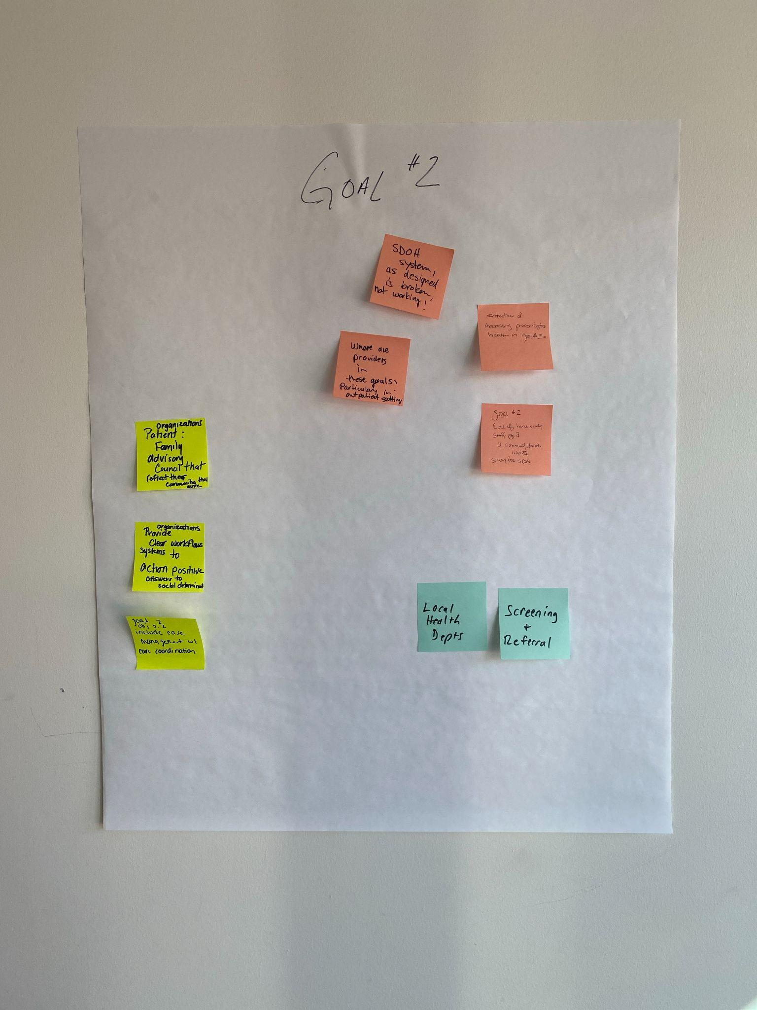
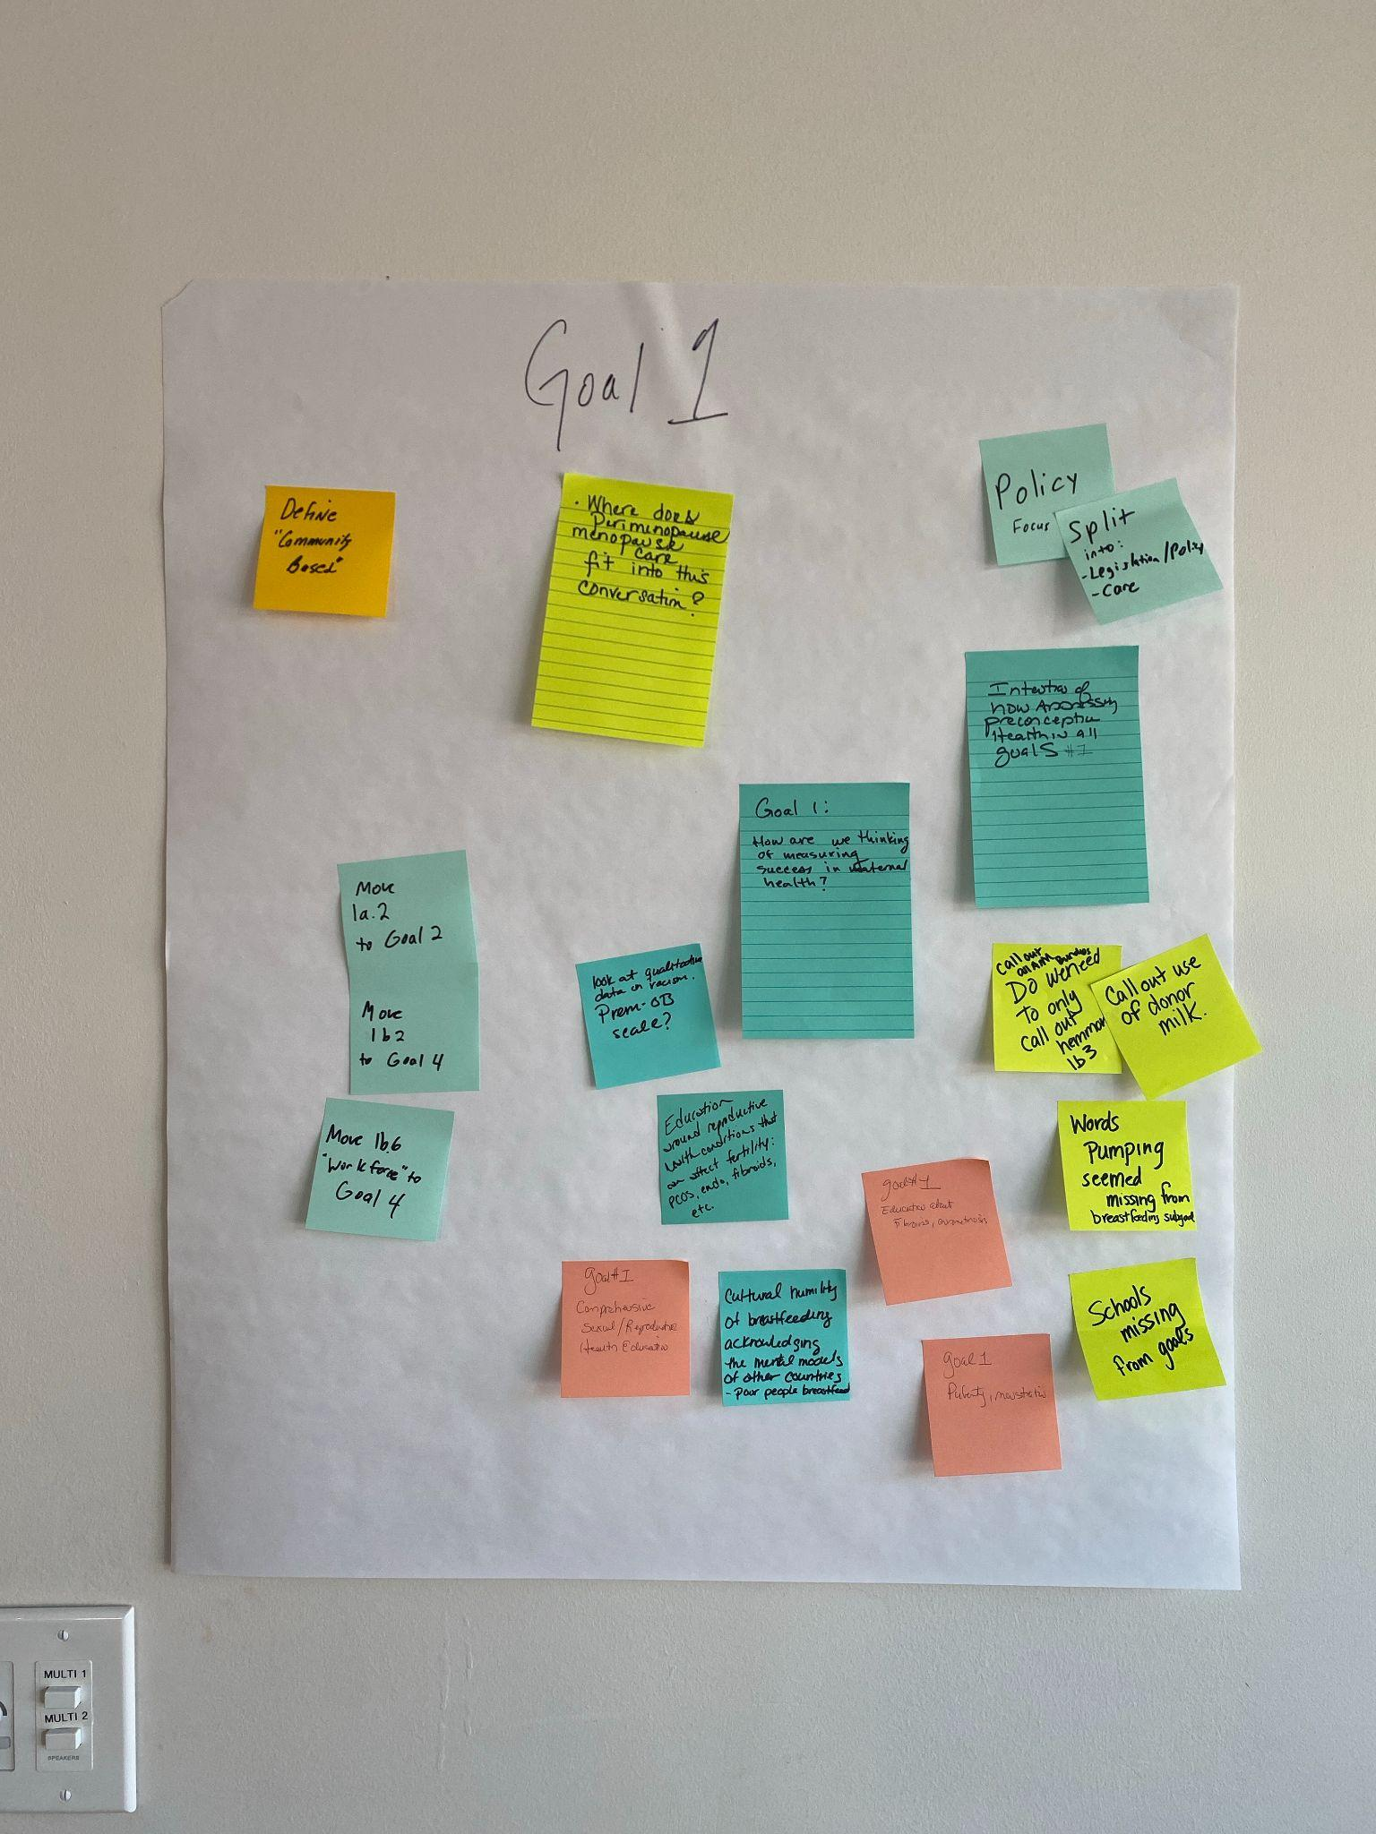

Slide 23
Sample Revisions based on Task Force Input
Comment: Education around reproductive health conditions that can affect fertility (e.g. PCOS, fibroids, endometriosis, etc.) >>>
  Added “Objective 1a.4: Provide education around reproductive health conditions that can affect fertility (e.g. PCOS, fibroids, endometriosis, etc.)”
Comment: Identify other standards for equity data that do not set the “gold standard” as the white outcome
  Updated: “Objective 3.6: Collect and regularly evaluate data to address root causes of inequity (i.e. structural racism) to close the equity gap, utilizing standards for equity data that do not set the “gold standard” as the white outcome”

Slide 24
See “APPENDIX A - Revised Goals and Objectives_10.22.24” for details of all changes

Slide 25
Maternal Health Data

Slide 26
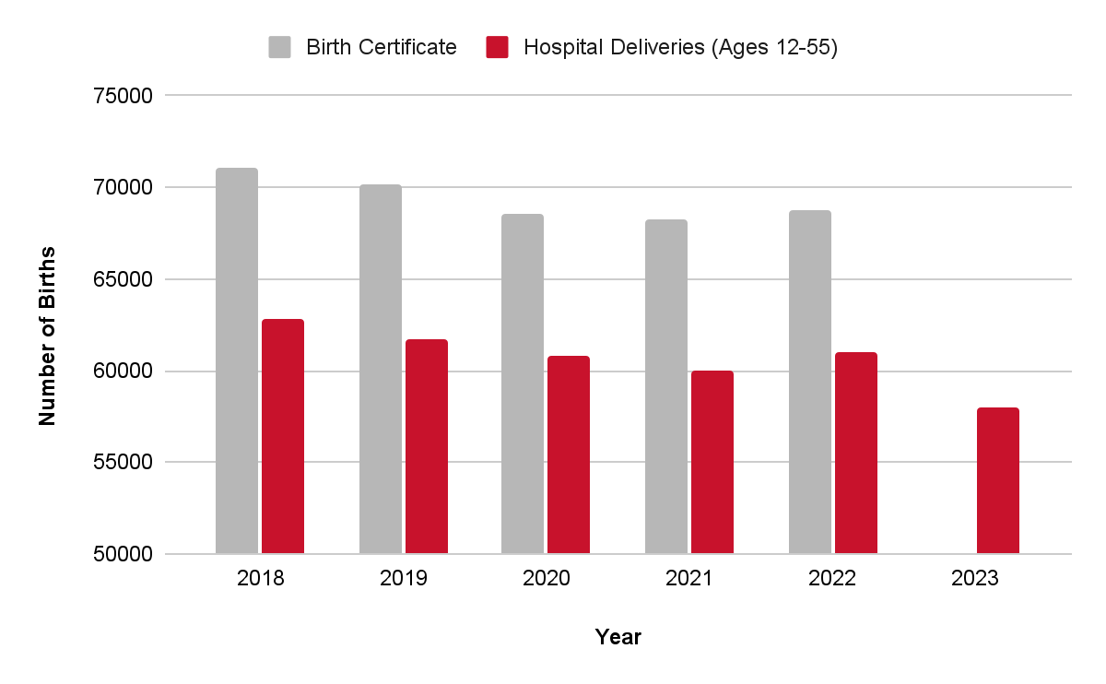

Maryland Births & Deliveries, 2018-2023
Average = 69376 births
Average = 60744 deliveries
Data sources: CDC Wonder Natality & MCHB Analysis of Health Services Cost Review Commission (HSCRC) Inpatient Case-Mix as of July 2024

Slide 27
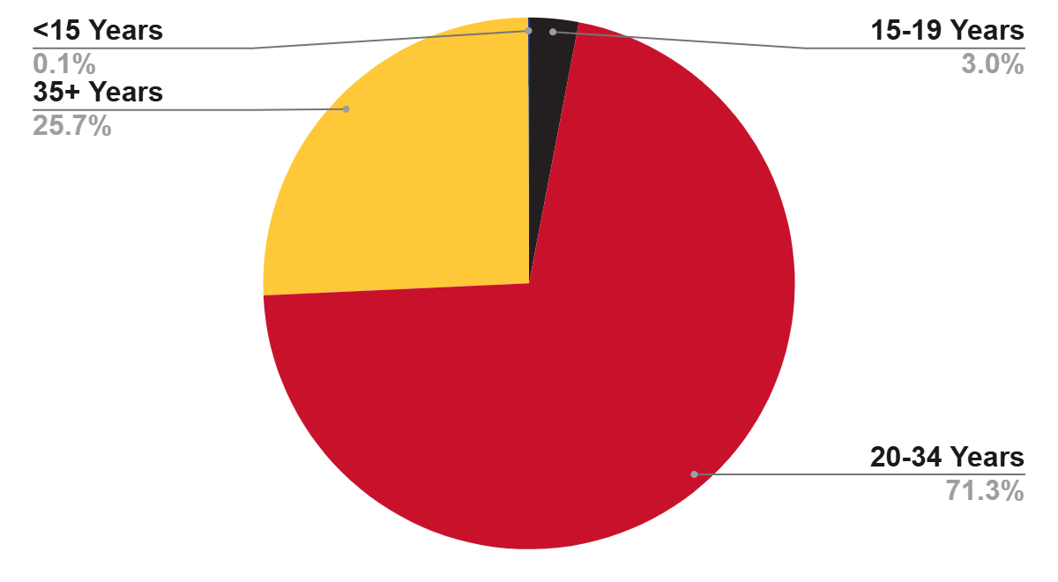
Births by Age, Maryland, 2022
Data source: Maryland Vital Statistics Administration, 2022 Annual Report
Note: Age “Not Stated” for four births in 2022

Slide 28
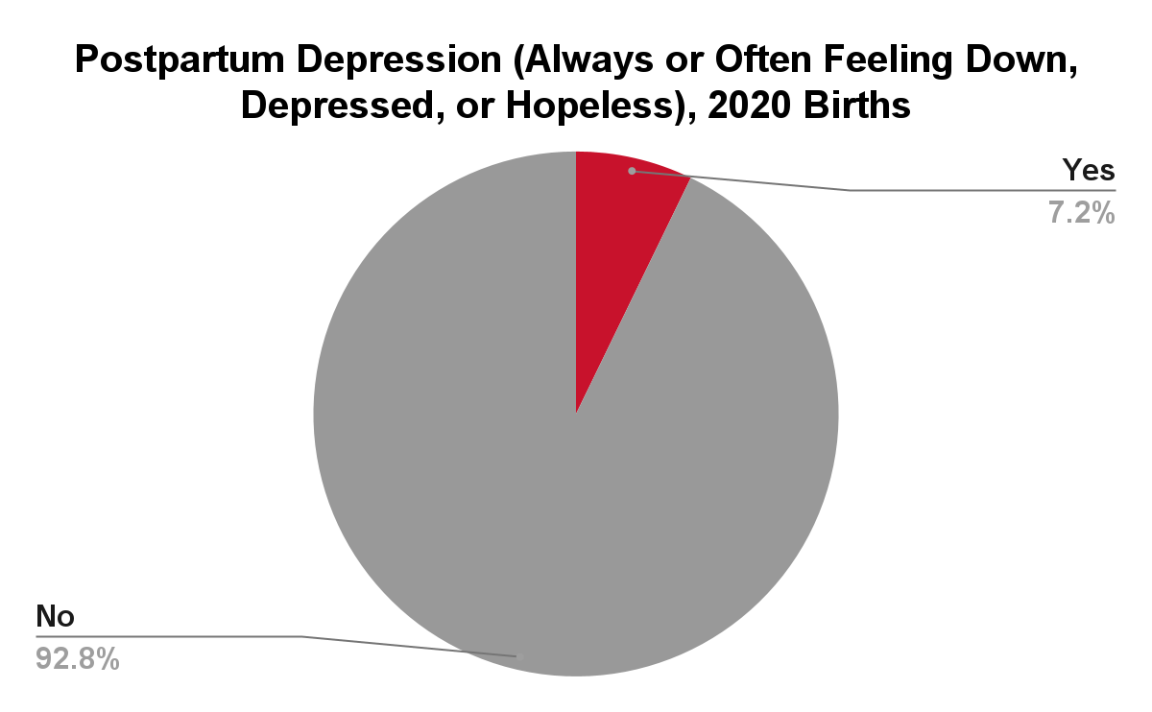
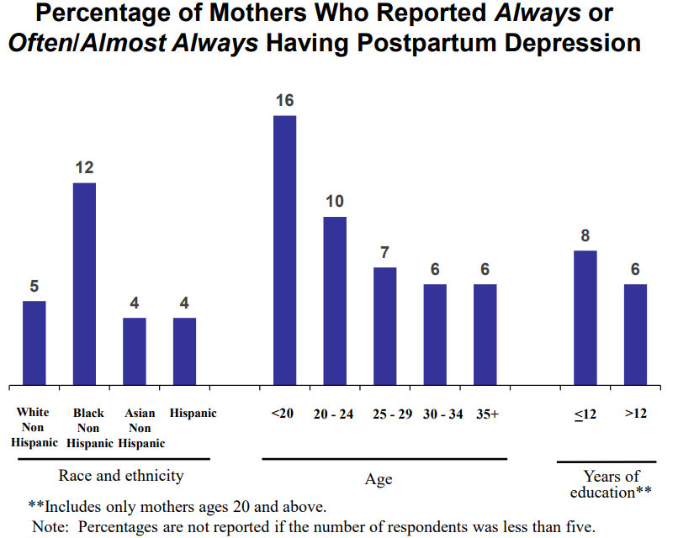
Postpartum Depression by Age, Race/Ethnicity, and Education Maryland, 2020
Data source: Maryland Pregnancy Risk Assessment Monitoring System (PRAMS) 2020 Annual Report, Page 60 (corrected)

Slide 29
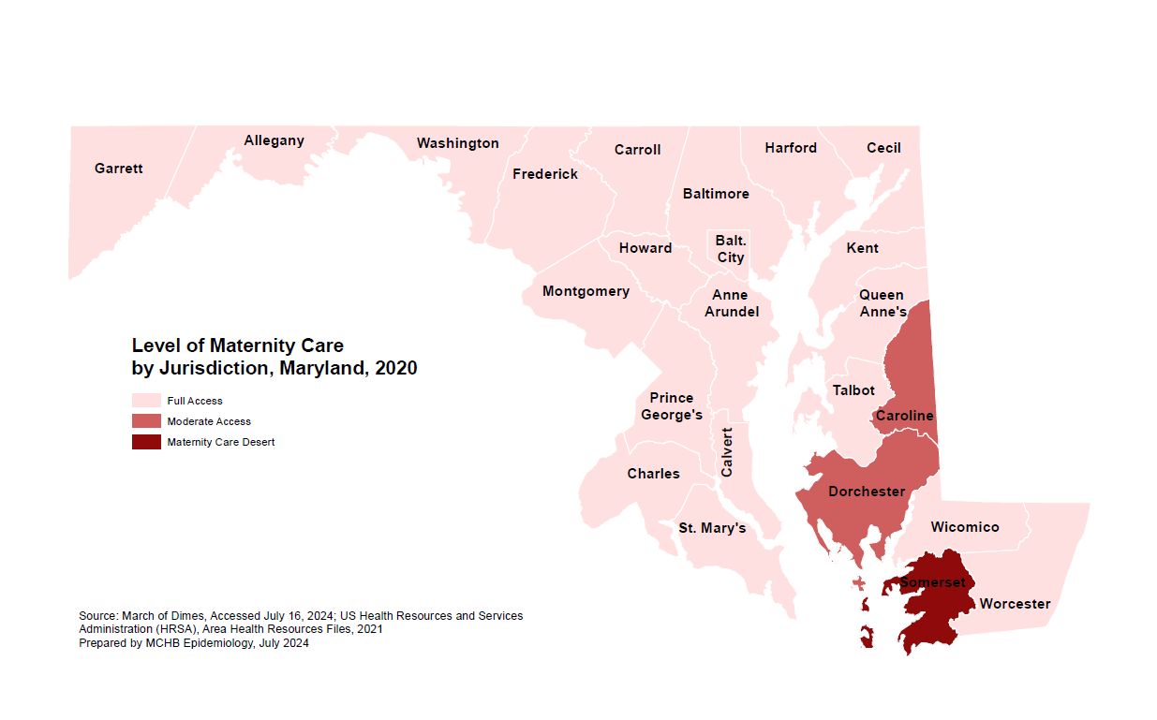

Slide 30
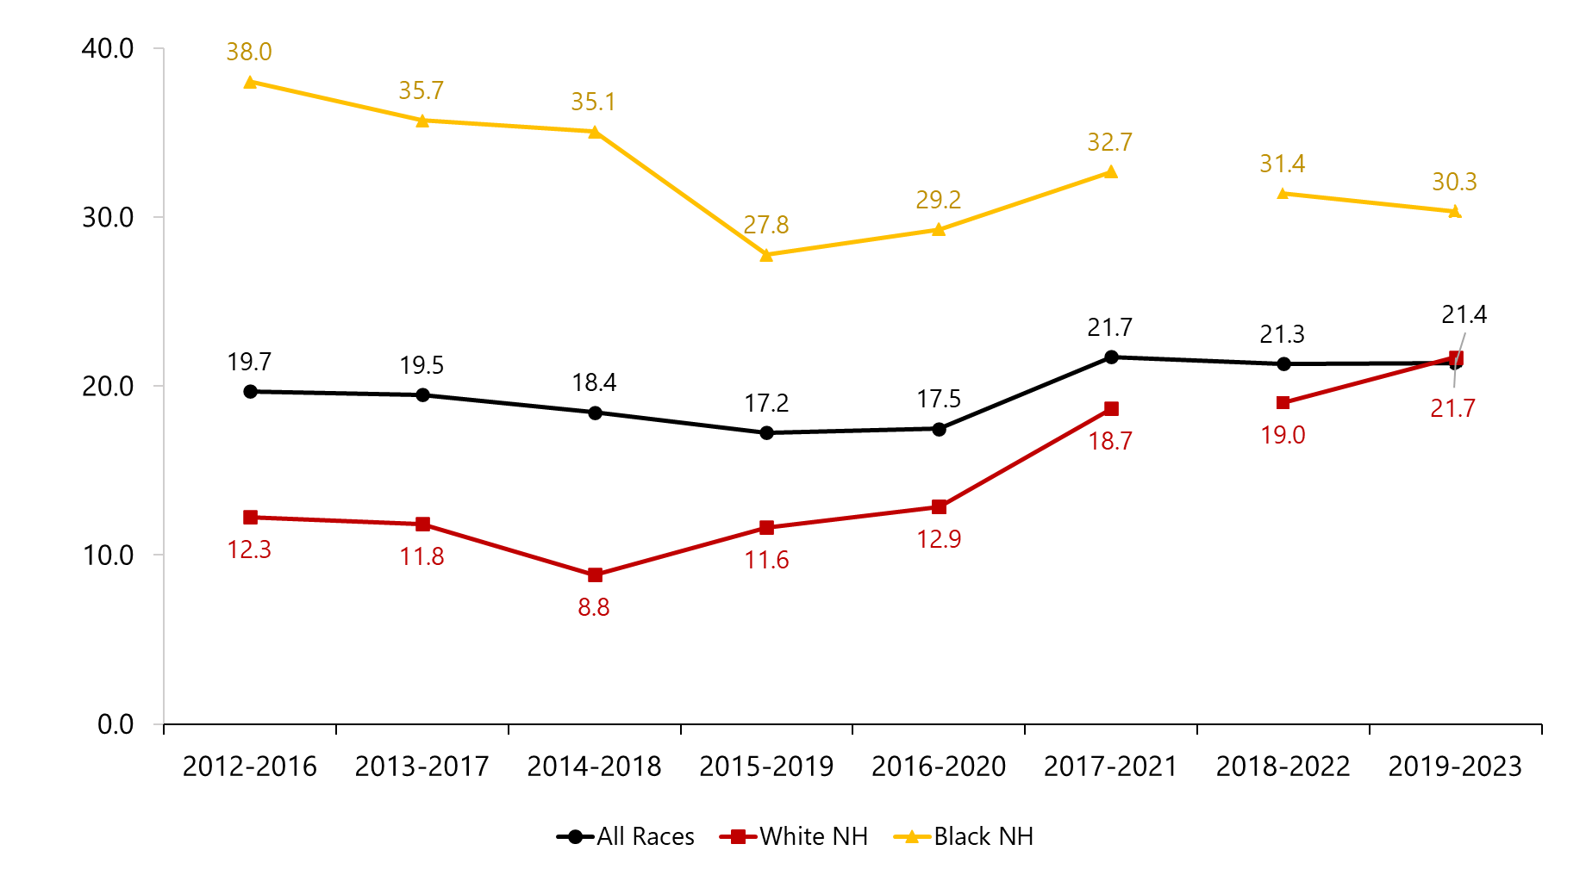
Five-Year Rolling Maternal Mortality within 42 Days by Race/Ethnicity, Maryland, 2016-2023
Source: CDC WONDER, obtained January 2025
Rate of maternal deaths per 100,000 live births, defined by ICD-10 codes: A34, O00-O95, and O98-O999
Notes: Rates for Black NH and White NH individuals for periods including and beyond 2018-2022 are not directly comparable to rates from previous periods
(indicated by a break in the line graph), due to changes in race classification methodology (2017-2021 and prior use bridged race methods or a combination of
bridged race and single race methods, while 2018-2022 onwards use single race methods)

Slide 31
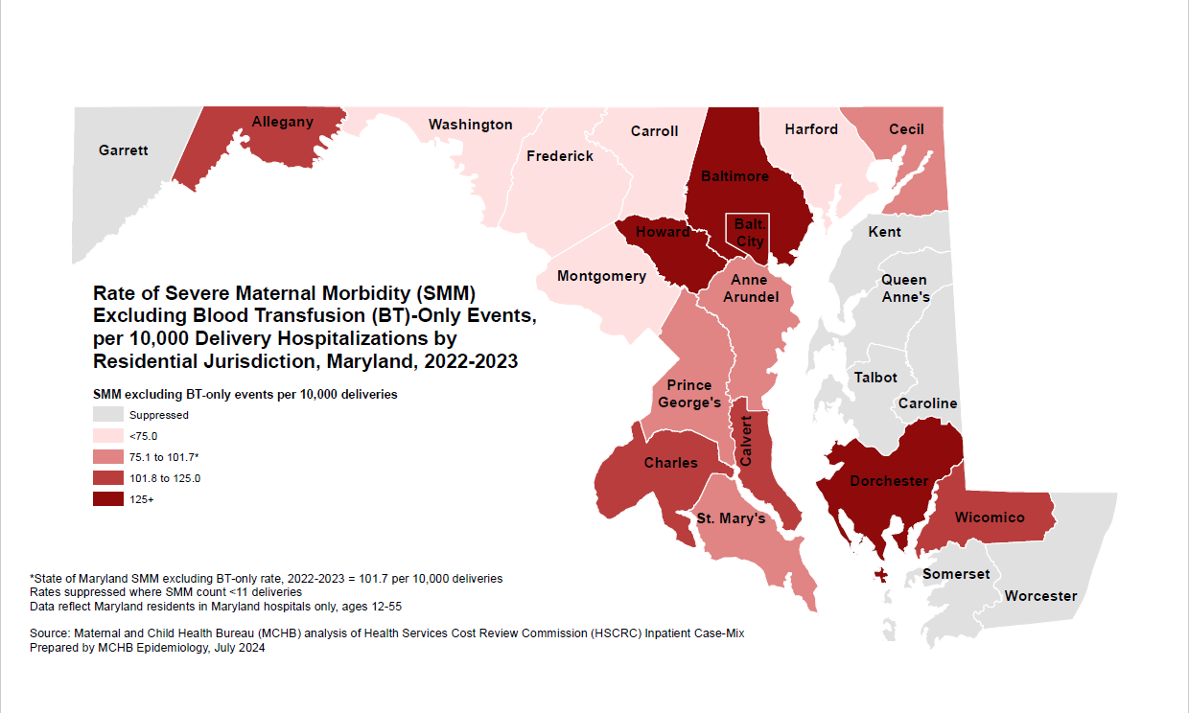

Slide 32
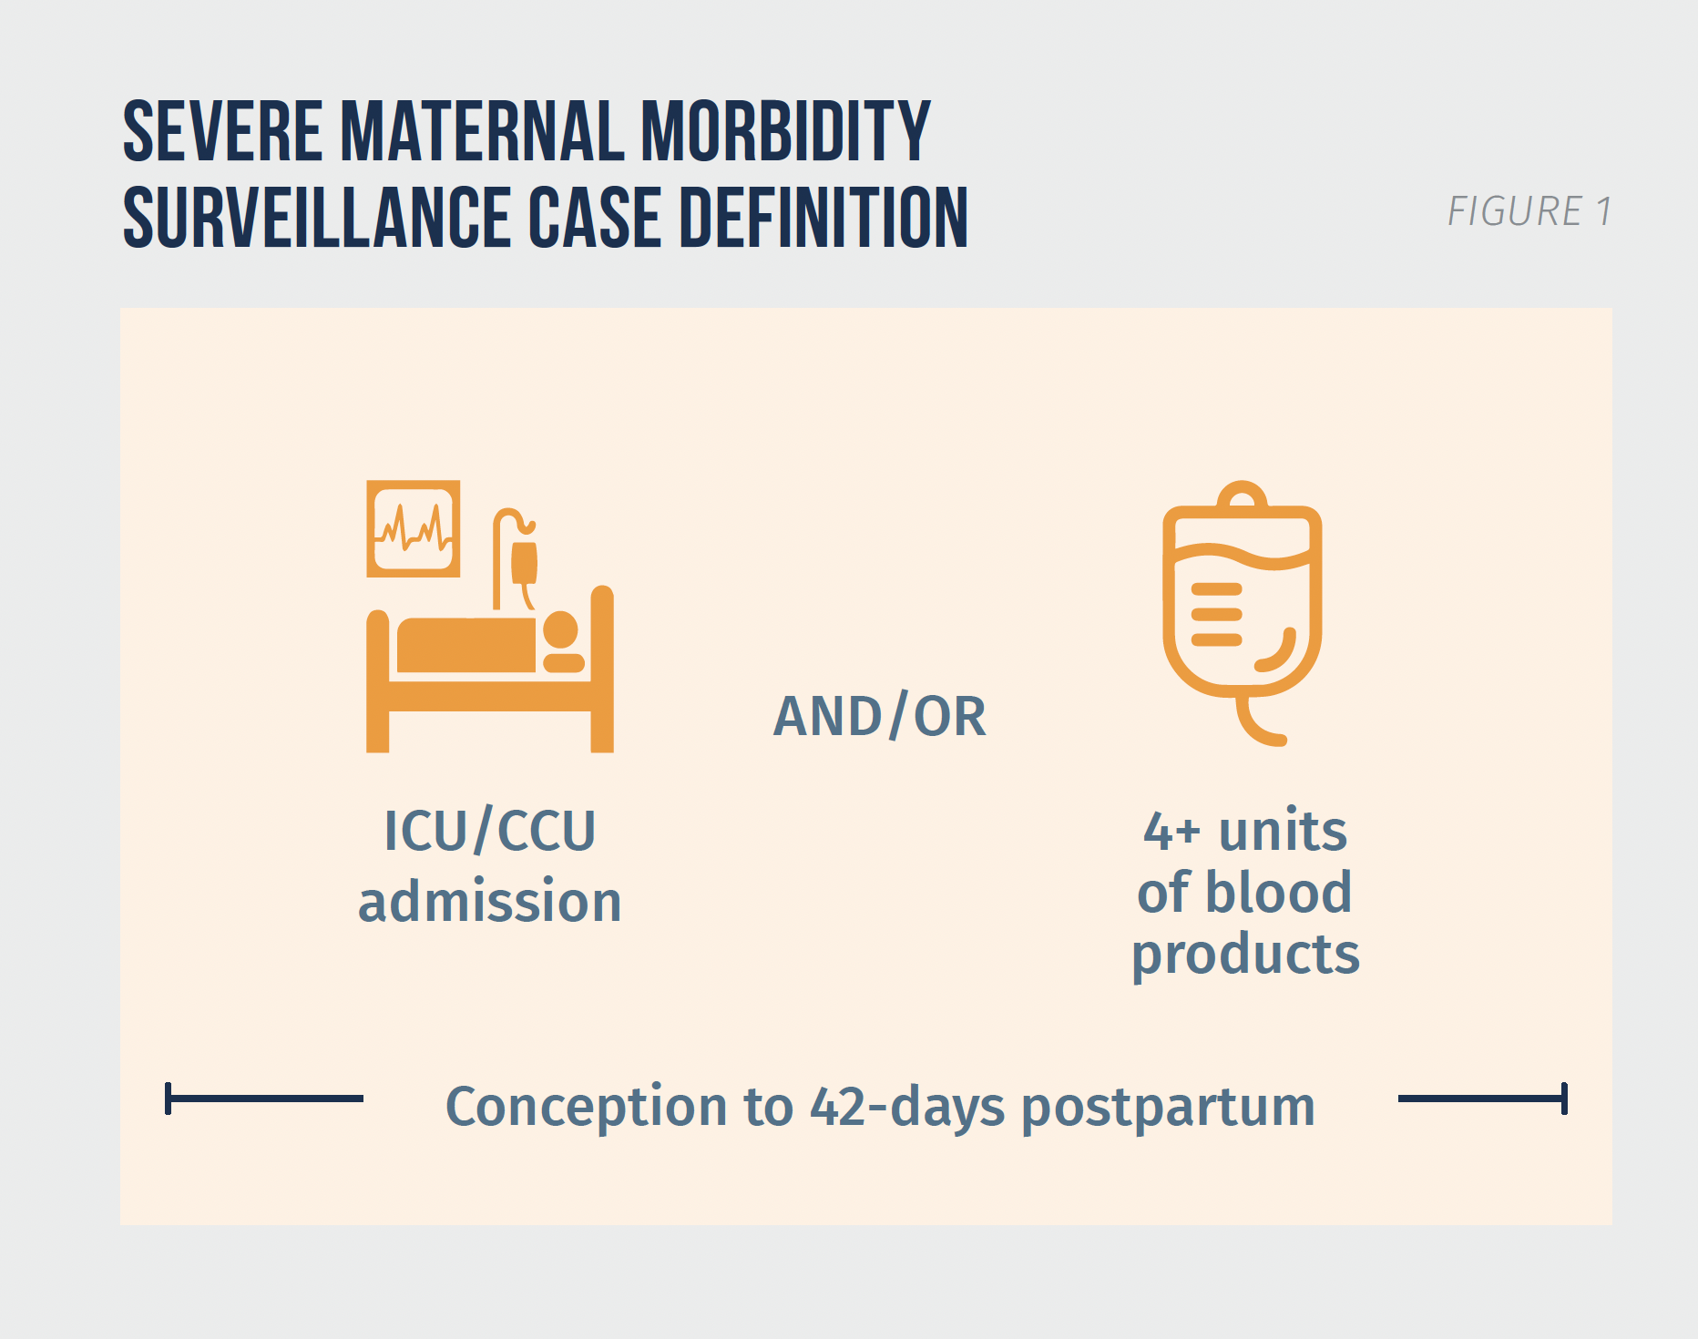
Severe Maternal Morbidity (SMM) Surveillance in Maryland – Key MDMOM Activity
Hospital-based systematic process for identification of severe maternal morbidity, clinical review and analysis
  ACOG/SMFM surveillance definition & guidelines
Objective is to identify risk factors, causes, and strategies to improve service delivery & quality of care
  Practices done well
  Preventability assessments
  Recommendations
Work on-going in 27 of 32 hospitals
  >80% annual births
  HB-1051/2024 mandates all hospitals’ participation
Data disseminated through hospital reports, data briefs, publications and presentations

Slide 33
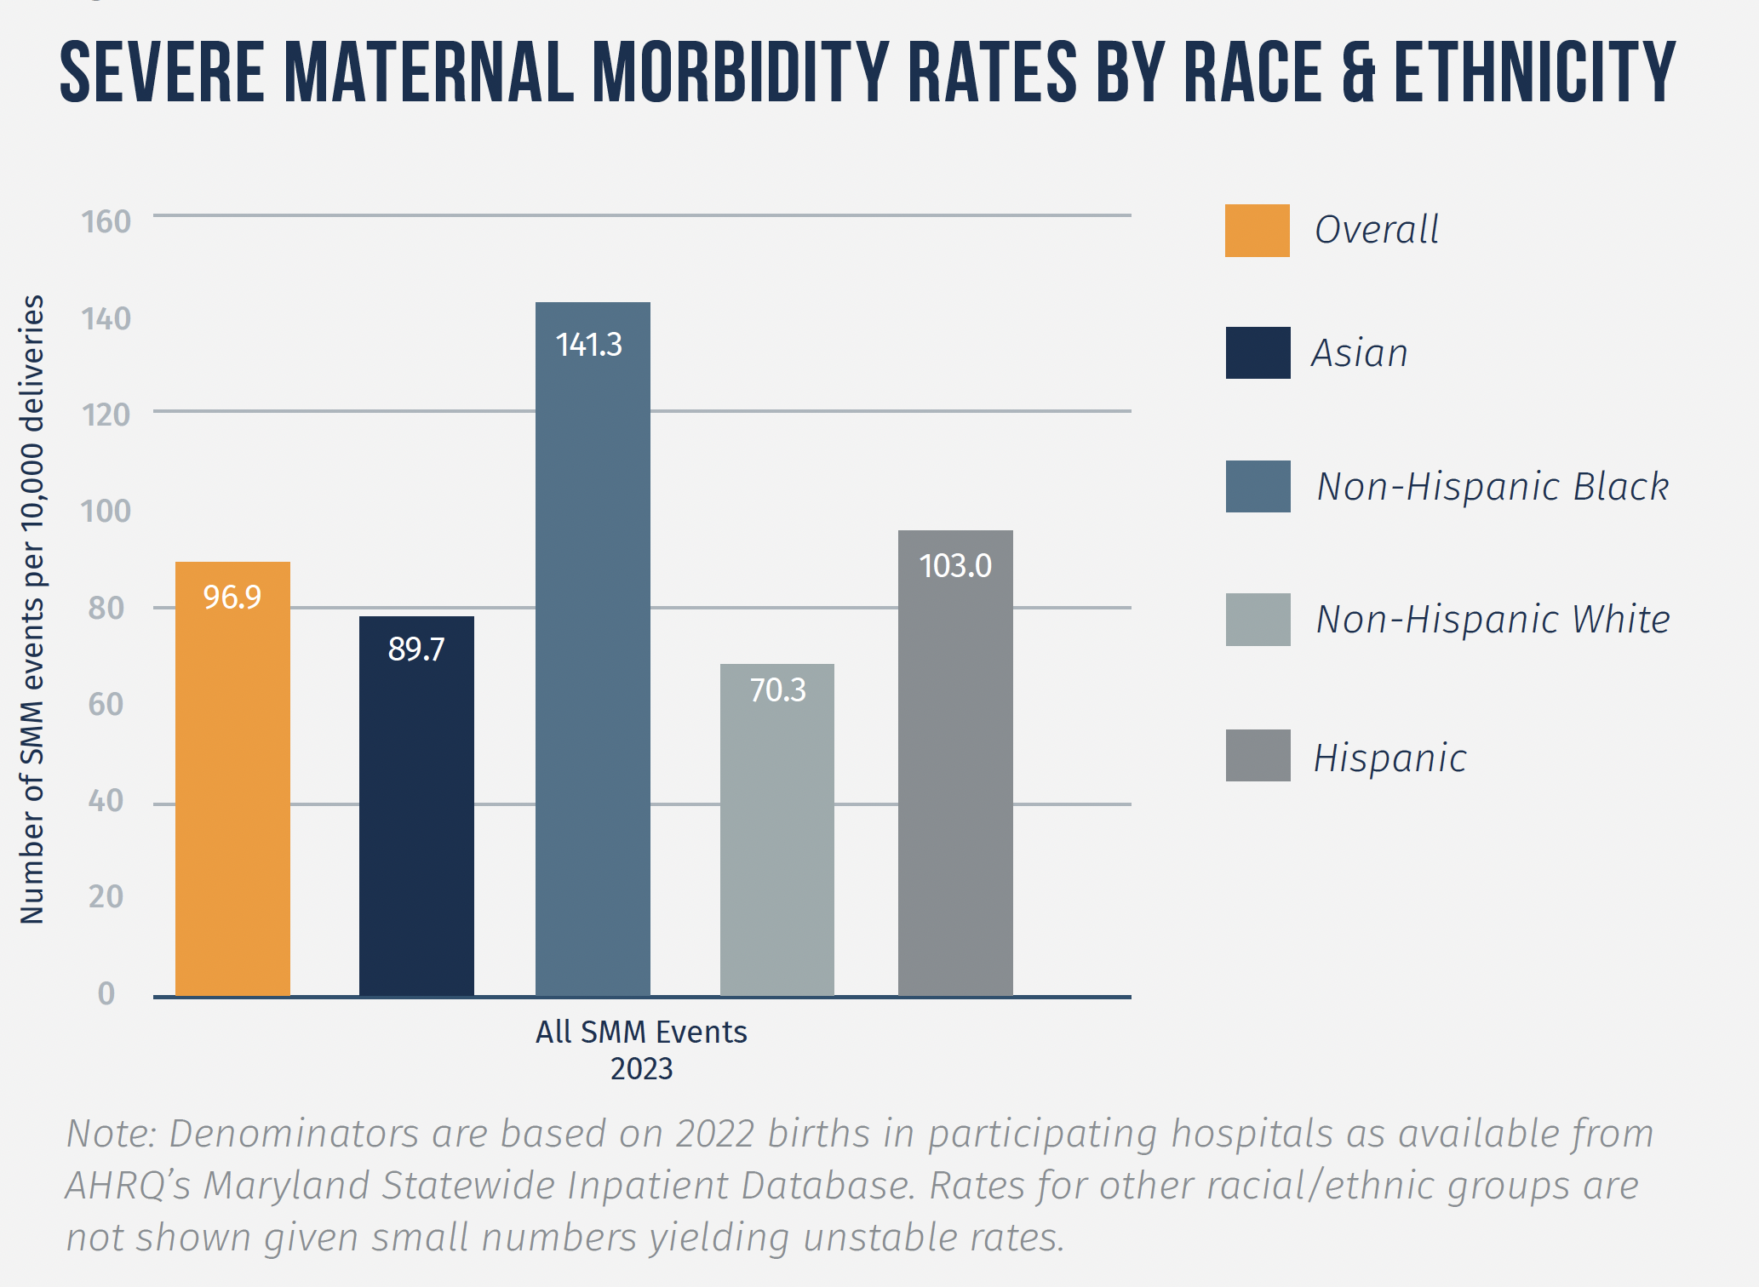
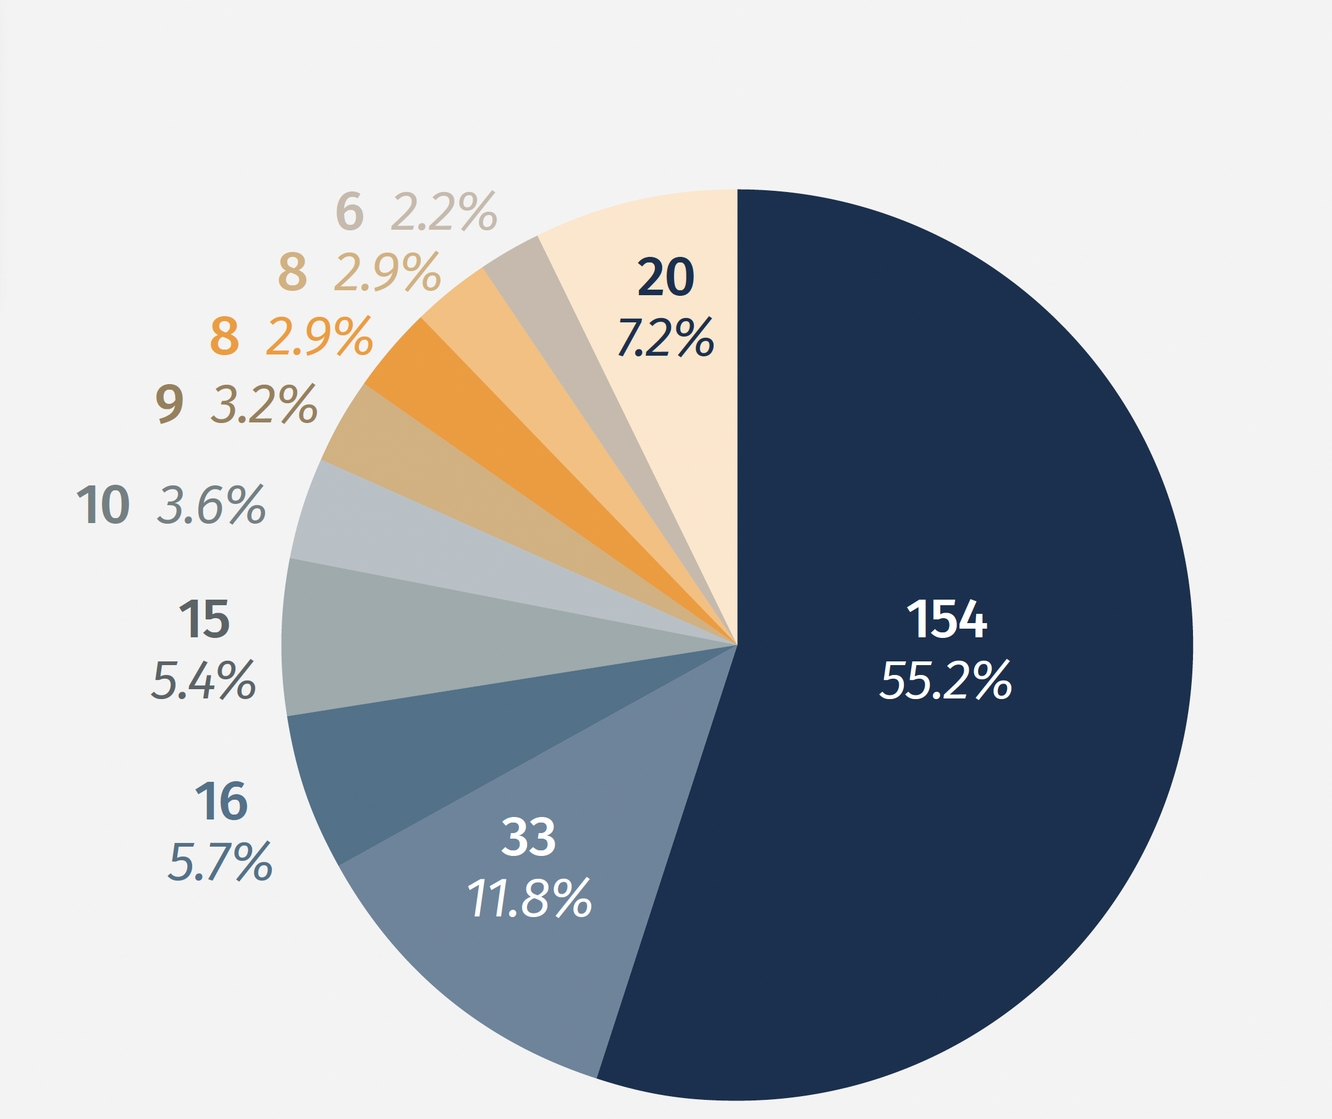

Key Findings from 2023 SMM Event Reviews

Slide 34





Next Steps to Enhance SMM Surveillance
Patient Interviews
Qualitative interviews with patients who experienced SMM (planned for fall 2024)
Provide information about social determinants of health and patient perceptions and expectations of care not available in clinical records
Hospital Review Equity Module
Will provide a systematic and standardized process for hospital-based SMM review committees to assess the role of racism and bias in patient care
To be introduced in 2025
Enhanced Assessment of Risks Associated with SMM
Statewide participation in SMM surveillance along with data on birth outcomes in the general population in Maryland will allow for calculation of risk and relative rates

Slide 35
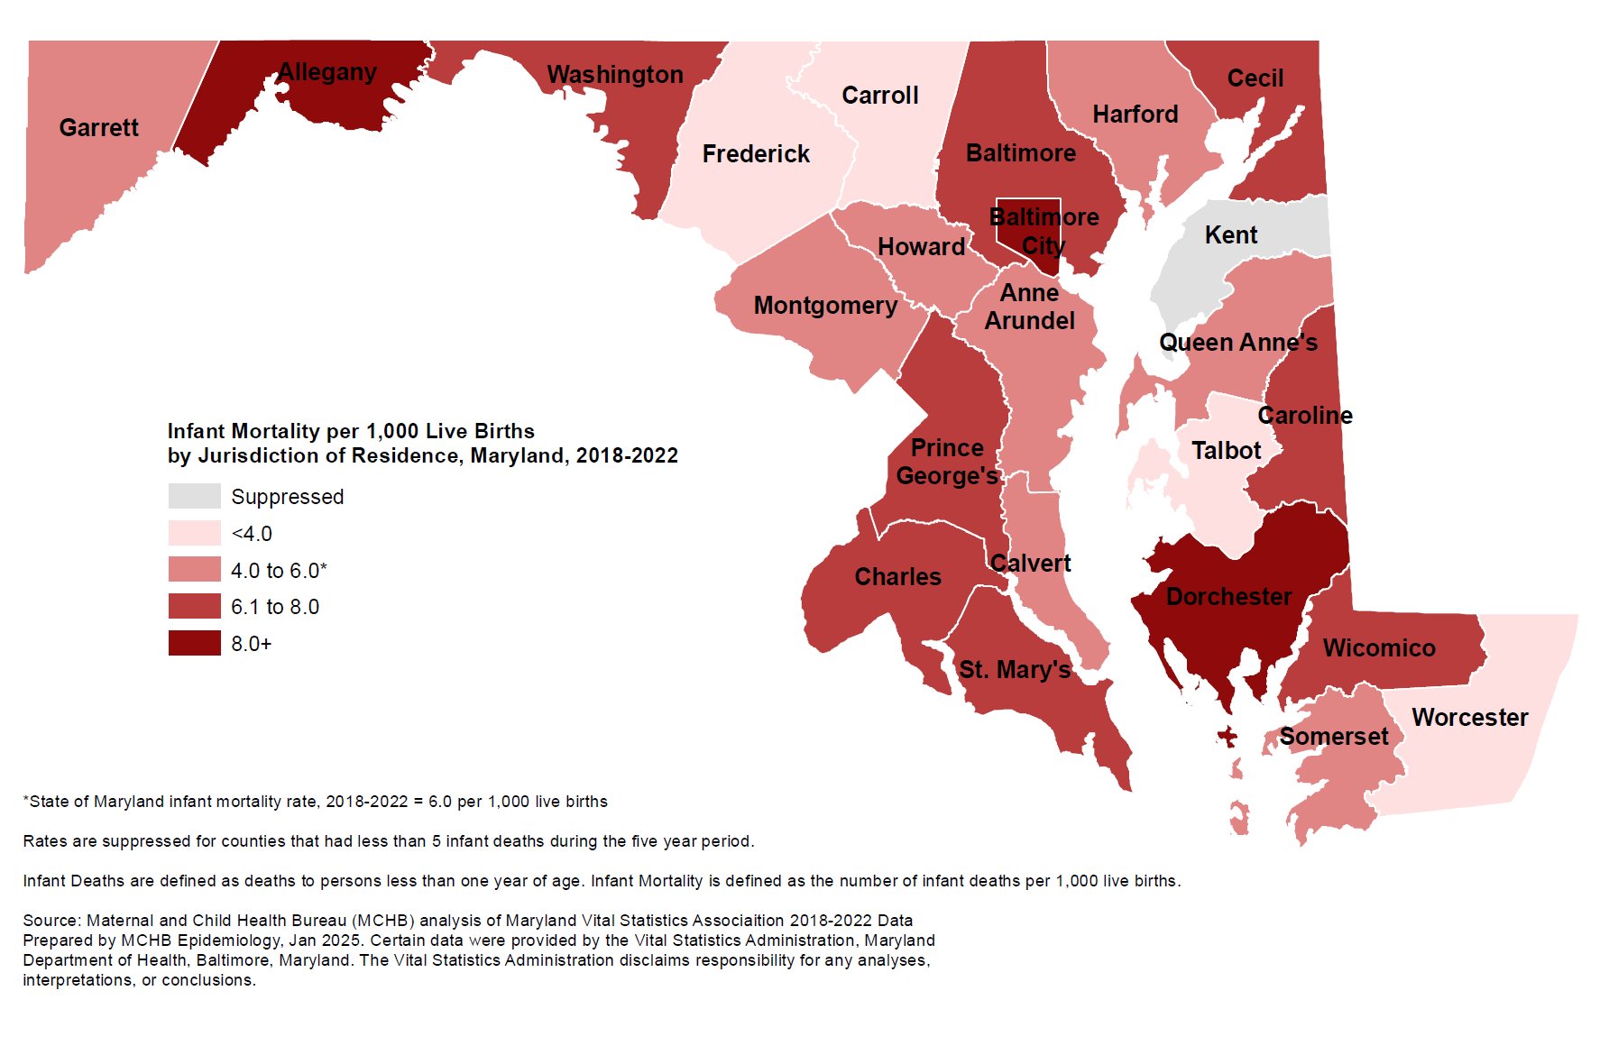

Slide 36
Group Discussion

Slide 37
Next Steps

Slide 38
2025 quarterly meetings (tent.)
April 22, 2025, 2:30-4:00pm
July 22, 2025, 2:30-4:00pm
October 28, 2025, 2:30-4:00pm

Slide 39
Appendix - Strategic Plan Goals and Objectives

Slide 40
Goal 1: Maternal health across the life course
Subgoal 1a: Preconception and interconception health
Objective 1a.1: Increase access to comprehensive, quality family planning and reproductive health services across Maryland..
Objective 1a.2: Improve prevention, diagnosis, and treatment of leading causes of maternal morbidity and mortality, including cardiovascular disease, hypertension, diabetes, and behavioral health conditions, and underlying structural determinants of racism and oppression.
Objective 1a.3: Enhance screenings (i.e. SBIRT), counseling, and medical and non-medical therapies should be utilized for behavioral health conditions, including substance use disorders, depression, and anxiety.
Objective 1a.4: Promote legislation establishing paid family leave and incentivizing employers to value a healthy pregnancy and postpartum period
Notes:
Full Subgoal 1a: Implement and/or support effective and accountable programs and policies that ensure birthing people can choose when to become pregnant and optimize their health in anticipation of the pregnancy.

Slide 41
Goal 1: Maternal health across the life course
Subgoal 1b: Prenatal and birth period: Achieve healthy pregnancies and birth outcomes.
Objective 1b.1: Expand the use of tools to refer and connect patients to resources, as identified in the Maryland Prenatal Risk Assessment (MPRA) and the Postpartum Infant and Maternal Referral Form (PIMR), and ensure connections are made based on those referrals. Referrals made based on these should meet the needs, desires, and preferences of birthing people who receive those services.
Objective 1b.2: Expand the number of clinical practices offering the CenteringPregnancy model.
Objective 1b.3: Reduce severe maternal morbidities due to maternal hemorrhage through evidence-based and inclusive strategies, such as the implementation of the AIM obstetric hemorrhage bundle
Objective 1b.4: Support providers to implement hemorrhage reduction strategies in a way that centers reproductive justice and patient experiences

Slide 42
Goal 1: Maternal health across the life course
Subgoal 1b: Prenatal and birth period: Achieve healthy pregnancies and birth outcomes.
Objective 1b.5: Increase enrollment in evidence-based and promising practice home visiting programs that offer social support, care coordination, and monitoring of changes in clinical risk factors
Objective 1b.6: Promote multidisciplinary efforts to support individuals in breastfeeding, including
  Strengthening the workforce to support breastfeeding, including providers such as community lactation specialists, certified breastfeeding specialists, and IBCLCs
  Something about hospital policies to align with support for parents in initiating and sustaining breastfeeding
  Providing resources to support parents in identifying a range of infant feeding options
  Providing linkages to care and education at multiple time points, including in preconception, prenatal, postpartum, and interconception periods, to support sustainable breastfeeding
  Ensuring payor reimbursement for lactation services

Slide 43
Goal 1: Maternal health across the life course
Subgoal 1b: Prenatal and birth period: Achieve healthy pregnancies and birth outcomes.
Objective 1b.7: Ensure ALL perinatal individuals have access to care and screening for complications and normalize mental health support in the perinatal period
Objective 1b.8: Provide educational resources to increase awareness of the importance of nutrition and physical activity for healthy pregnancies that center cultural humility and honor the diverse body types of individuals without causing harm.
Objective 1b.9: Promote legislation establishing universal health insurance coverage, robust housing and child care for birthing people
Objective 1b.10: Promote legislation establishing well-trained and respectful healthcare navigators for birthing people

Slide 44
Goal 2: Develop strategies that acknowledge the influence of the social and structural determinants of health and racism and cultivate an environment in which birthing people, families, and communities thrive.
Objective 2.1: Improve family and community-driven service provision such as care coordination
Objective 2.2: Advocate for investment in safe, affordable, and sustainable housing and healthy communities that ensure a quality of life for all to live their best lives, which is smoke-free, tobacco-free, lead-free, violence-free, and free from environmental hazards.
Objective 2.3: Support the increase in community gardens, green spaces, and tree canopies, especially in neighborhoods with historical omissions and disinvestment through redlining.
Objective 2.4: Recognize the assets and strengths of fathers, partners, and non-birthing parents in the birthing and postpartum experience and develop programs and services that address specific needs of fathers and partners that may arise during pregnancy and postpartum transitions. These programs and services should recognize the diversity of family compositions.

Slide 45
Goal 2: Develop strategies that acknowledge the influence of the social and structural determinants of health and racism and cultivate an environment in which birthing people, families, and communities thrive.
Objective 2.5: Support the use of evidence-based strategies to holistically address violence within families and communities that address the underlying structural drivers of violence.
Objective 2.6: Ensure equitable representation of rural communities in all maternal health efforts
Objective 2.7: Establish and invest in free-standing birth centers in the community, especially in areas with high maternal mortality and morbidity and regions identified as maternal health deserts in the state. The birth centers will follow the guidance and regulations of the American Association of Birth Centers, the national multidisciplinary organization dedicated to the birth center model of care.

Slide 46
Goal 3: Improve the ongoing collection and utilization of data on maternal health outcomes (including data on structural racism and its impact on maternal health) to help birthing people make informed family planning and healthcare decisions
Objective 3.1: Regularly evaluate the causes of maternal mortality and severe maternal morbidity in Maryland through analysis of surveillance data and facility-based case reviews with a focus on social and structural determinants of health.
Objective 3.2: Enhance maternal health surveillance and quality initiatives through the collection of humanizing qualitative data that captures the perspectives of mothers with lived experience.
Objective 3.3: Maintain quality, accessible maternal health data on the new a centralized state-wide maternal health dashboard
Objective 3.4: Promote new Maryland maternal health dashboard to provide birthing people with the data they need to make informed peripartum decisions (e.g. where to deliver)

Slide 47
Goal 3: Improve the ongoing collection and utilization of data on maternal health outcomes (including data on structural racism and its impact on maternal health) to help birthing people make informed family planning and healthcare decisions
Objective 3.5: Track data on healthcare access and outcomes and hold maternal health health systems and providers accountable for providing equitable, high-quality care
Objective 3.6: Collect and regularly evaluate data to address root causes of inequity (i.e. structural racism) to close the equity gap
Objective 3.7: Implement better patient experience surveys that include humanizing qualitative data and allow patients to identify any treatment gaps they experience in their perinatal care
Objective 3.8: Develop a data system mechanism that will track the number of high-risk birthing people through the Maryland Prenatal Risk Assessment (MPRA) and the Postpartum Infant Maternal Referral (PIMR) forms and support completion of referrals made during the prenatal period to services and resources. This is particularly for referrals involving mental health, substance use, and intimate partner violence (IPV

Slide 48
Goal 4: Ensure that the state of Maryland has a diverse, well-trained and accessible workforce of maternal health providers, advocates and support staff that represents the birthing community and offers services based on the principles of cultural humility, equity, and racial justice.
Objective 4.1: Implement cultural competency training for providers who engage with birthing people, such as health care providers, local health department staff, home visitors, community health workers, and other staff that directly support families and newborns
Objective 4.2: Work to promote comprehensive Medicaid coverage for doula services that includes prenatal and postpartum visits, competitive reimbursement rates, and evaluate the impact of the coverage on the number of trained and certified doulas and doula availability to low-income mothers in Maryland.
Objective 4.3: Evaluate the impact of new Medicaid coverage for doula services on the number of trained and certified doulas and doula availability to low-income mothers in Maryland

Slide 49
Goal 4: Ensure that the state of Maryland has a diverse, well-trained and accessible workforce of maternal health providers, advocates and support staff that represents the birthing community and offers services based on the principles of cultural humility, equity, and racial justice.
Objective 4.4: Increase the number of providers working with birthing people who screen for substance use and/or behavioral health conditions and refer positive screens for treatment through the Maryland SBIRT (Screening, Brief Intervention, Referral to Treatment) initiative.
Objective 4.5: Increase accessibility to prenatal care as well as oral and behavioral health during the prenatal period in communities with members who face barriers to receiving prenatal care (e.g., immigration status) via mobile health units.
Objective 4.7: Implement effective bias training for all maternal health providers and require that bias training is ongoing throughout the provider's career .

Slide 50
Goal 4: Ensure that the state of Maryland has a diverse, well-trained and accessible workforce of maternal health providers, advocates and support staff that represents the birthing community and offers services based on the principles of cultural humility, equity, and racial justice.
Objective 4.6: Increase investment in workforce training and education opportunities to build a diverse maternal health workforce through:
  Objective 4.6a: Establishing scholarships/financial incentives for training of black and brown certified midwives and OB/Gyn doctors
  Objective 4.6b: Increasing the number of Black and Brown medical trainees in State funded institutions and organizations
  Objective 4.6c: Partnering with existing STEM programs for historically underrepresented learners to increase exposure to careers in Women's Health

Slide 51
Goal 4: Ensure that the state of Maryland has a diverse, well-trained and accessible workforce of maternal health providers, advocates and support staff that represents the birthing community and offers services based on the principles of cultural humility, equity, and racial justice.
Objective 4.8: Increase the number of mental health and substance use disorder providers available to assist and support birthing persons and their families across the state
Objective 4.9: Establish a robust community health worker workforce to assist and support birthing persons and their families across the state
Objective 4.10: Ensure the availability of high-quality, culturally responsive interpreter services for every birthing person who needs an interpreter, and support livable compensation and/or reimbursement rates for interpreters
Objective 4.11: Use data to identify prenatal and perinatal “care deserts” and staff additional maternal health providers to those communities

Slide 52
Goal 5: Develop equitable and sustainable sources of funding for maternal health programs and initiatives
Objective 5.1: Strive for better reimbursement management and require appropriate reimbursement for insurance-based practitioners
Objective 5.2: Ensure equitable distribution of funding streams in maternal health programs
Objective 5.3: Establish sustainable sources of funding for key programs and initiatives in maternal health, including funding for:
  Community practitioners to provide holistic services
  Training and certifications that increase knowledge and understanding of perinatal mood and anxiety disorders, such as those offered by the Postpartum Support International, the Shades of Blue Project, the Seleni Institute, and others.
  CBOs and not just medical systems or non-profits
  To assist birthing persons with healthcare costs beyond the hospital
Objective 5.4: Provide financial accountability mechanisms for money spent and work done on maternal health programs and initiatives

